Slide 1
Intelligent Cold Room Access Control and Monitoring System Using Face Recognition
B.S.K. PERERA-2021/E/022
D.M.C.P. GUNARATHNA-2021/E/030
L.M.N.H. DE MEL-2021/E/082
W.G.G.Y.WICKRAMARATHNE-2021/E/193

Slide 2
Problem Addressed
Our project tackles the issue of safety and security in cold rooms, where unauthorized access or trapped individuals due to malfunctioning doors can lead to accidents like hypothermia.

Slide 3
Functionality
The system uses face recognition for access control, tracks the time of entry, and alerts if someone has stayed too long (over 20 minutes) inside the cold room. It also allows staff to mark their exit, ensuring accountability and safety.

Slide 4
Why It’s Useful for an Embedded System Embedded System Relevance
The system combines
  real time monitoring
  security protocols
  automatic control
  using the ESP32-CAM module, making it a perfect example of an embedded system used to solve practical, real world issues.

Slide 5
Purpose
  Prevents accidents by ensuring that people don’t stay too long in cold environments.
  Enhances operational efficiency by tracking who is inside and when they enter/exit.
  Provides security by allowing only authorized personnel to access the cold room.

Slide 6
Hardware Components
  ESP32 Camera Module : Core processing and control unit and Captures images for face recognition.
  Servo Motor: Controls the automatic door system.
  Power Supply Unit: Ensures stable operation.
  7805 Regulator: Provides a stable 5V output for components.
  Relay Module: Controls high power devices such as the door motor.
  UART TTL Programmer: Facilitates programming and debugging of the ESP32 microcontroller.

Slide 7
Software Technologies
  Face Recognition Library: OpenCV for facial recognition.
  Database: Firebase or MySQL for logbook storage.
  UI/UX: Web dashboard or mobile app for real-time monitoring.
  Embedded Coding: Developed in C/C++ for ESP32 using ESP-IDF.

Slide 8
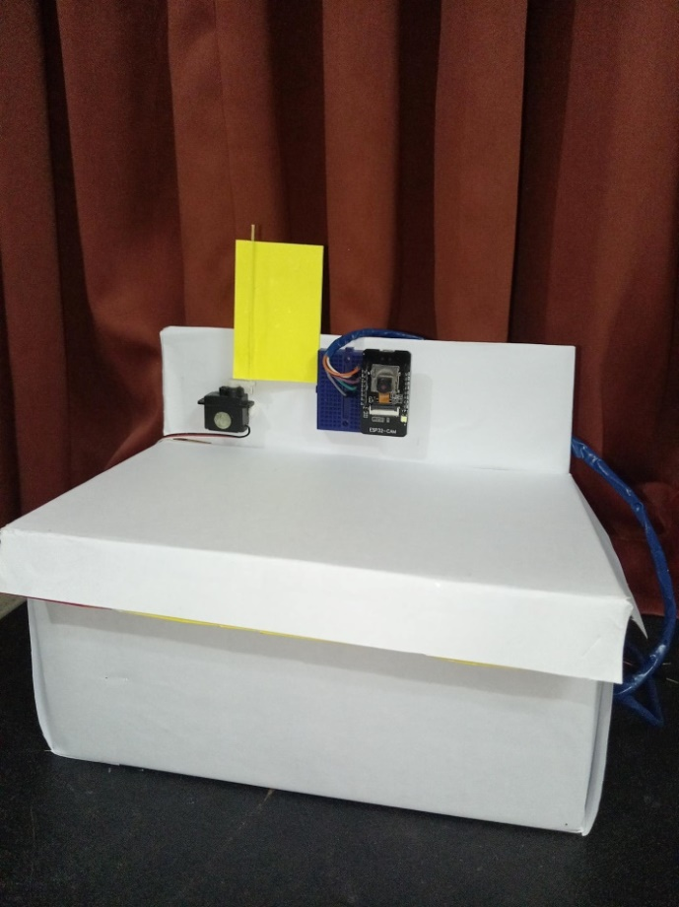
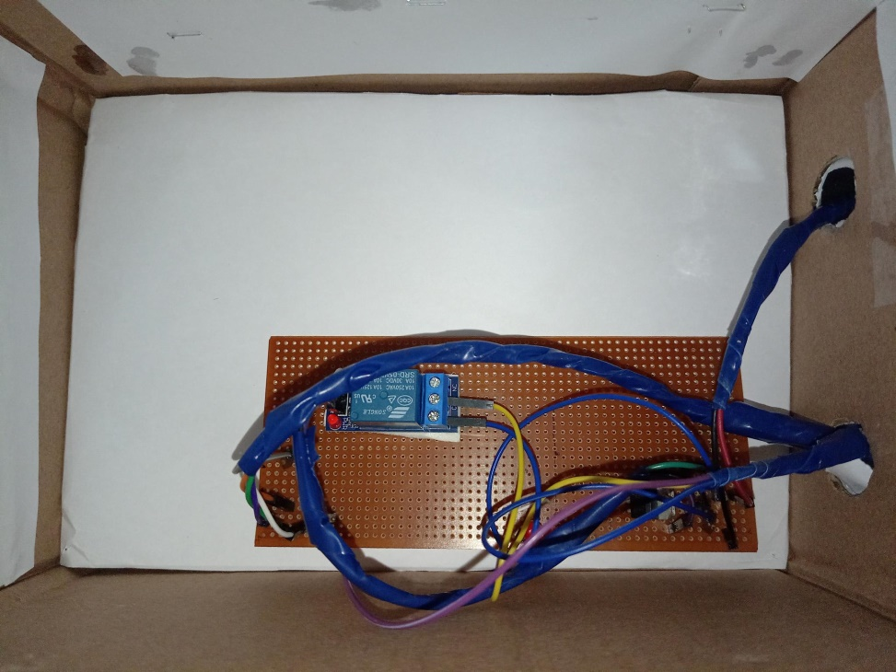
Prototype

Slide 9
System Architecture
  The system integrates hardware and software components to control access and monitor activity in the cold room.
  Face Recognition Module: Identifies and verifies authorized personnel.
  Door Control Mechanism: Actuates automatic door opening/closing.
  Timer and Alert System: Tracks the time spent by individuals and issues alerts if the allowed time is exceeded.
  Logbook Module: Logs employee ID, entry time, and exit time in a database.

Slide 10
Workflow
Person Approaches Cold Room
  Face recognition is triggered using the ESP32-CAM.
  If the face matches the database, the door is opened.
Entry Time Recorded
  The time of entry is logged.
Monitoring Prolonged Stay
  The system tracks the person’s time inside the cold room. If they stay longer than 20 minutes, an alert is triggered.
Exit Confirmation (If Before 20 Minutes)
  Outside the cold room, the person marks their name on the tab to confirm they’re leaving.

Slide 11
UNIQUENESS
Enhanced Safety by integrating a timer-based alert system
Access Control with Accountability
Prevention of Critical Incidents like employees were trapped inside cold rooms
Market Differentiation

Slide 12
COMPARISONS WITH EXISTING SOLUTIONS
Our project provides an all-in-one solution for access control, monitoring, and safety, unlike existing systems that typically address these issues separately. The integration of face recognition with a time-based alert system and logbook functionality makes it a unique offering.

Slide 13
CHALLENGES
The issue is that face detection and recognition functionality has been removed from the default ESP32 core for boards like the ESP32-CAM.
This is because the library was updated and no longer supports older ESP32 chips.
The old versions of the library that did support those chips also cannot be compiled with newer versions of the ESP-IDF, forcing the removal of the feature.

Slide 14
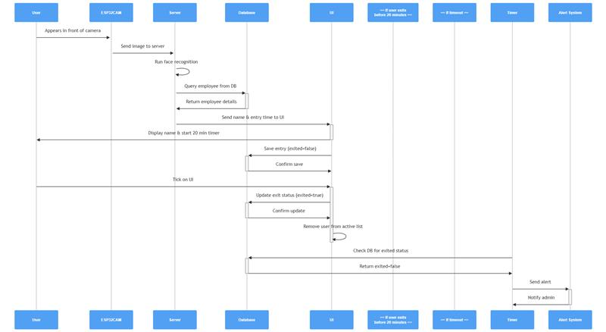
Sequence diagram

Slide 15
THANK YOU

